Slide 1

CUSTOMER CHURN PREDICTION
DSF –PT9
PHASE THREE

Slide 2
BUSINESS UNDERSTANDING
SyriaTel is a Telecommucations company facing a customer churn challenge leading to revenue loss and increased acquisition costs. This report presents a predictive analysis using machine learning models to identify customers at risk of churn and suggests actionable strategies for retention.
Data analysis will help to the organization describe customer’s behavior, understand their habits, develop appropriate marketing plans.
SyriaTel has to identify sales transactions and trends in order to build a long-term loyalty relationship with its customer base.

Slide 3
BUSINESS OBJECTIVES
Improve retention through targeted retention strategies.
Increase customer lifetime value by keeping customers longer.
Use cost-effective retention strategies
Targeted Marketing campaigns and promotions to acquire more Customers
Enhance the customer experience
Minimize churn rate by identifying at-risk customers.

Slide 4
Model Evaluation Summary
The following machine learning models were evaluated:
Model | Accuracy | Precision | Recall | F1 Score | ROC-AUC
Logistic Regression | 0.882 | 0.625 | 0.143 | 0.233 | 0.799
Decision Tree | 0.905 | 0.644 | 0.543 | 0.589 | 0.750
Random Forest | 0.929 | 0.875 | 0.500 | 0.636 | 0.872
XGBoost | 0.932 | 0.864 | 0.543 | 0.667 | 0.875
Key Findings
XGBoost and Random Forest are the most effective models, with the highest ROC-AUC scores (0.87).
Logistic Regression has lower recall (0.14), meaning it fails to capture many churn cases.
Decision Tree is prone to overfitting, as indicated by its relatively lower AUC score (0.75).

Slide 5
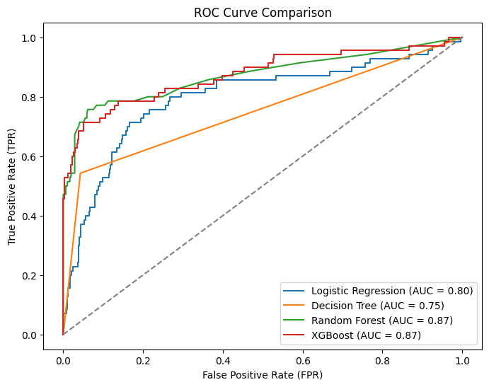
ROC CURVE
An AUC of 87% suggests that the model is doing a great job in predicting customer churn and provides Syriatel with a solid basis for effective churn prevention strategies.
87% AUC in essence denotes the model's ability to separate churners from non-churners based on the predicted probabilities.

Slide 6
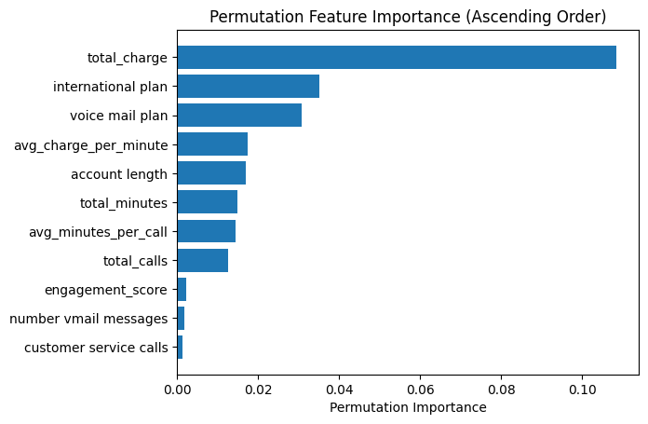
Business insights from Churn prediction
The most influential factors driving customer churn include:

Slide 7
Retention strategy recommendations
Based on the predictive insights, businesses should:
Proactively Engage High-Risk Customers – Target customers flagged by XGBoost and Random Forest with personalized retention offers.
Improve Customer Service Response Times – Address complaints efficiently by developing a timeframe for complaint resolution to reduce churn.
Offer Tiered Pricing Plans – Provide customized pricing to retain price-sensitive customers.
Enhance Customer Loyalty Programs – Reward loyal customers and encourage long-term engagement.
Automate Predictive Alerts – Integrate churn models into CRM systems to provide real-time intervention strategies.

Slide 8
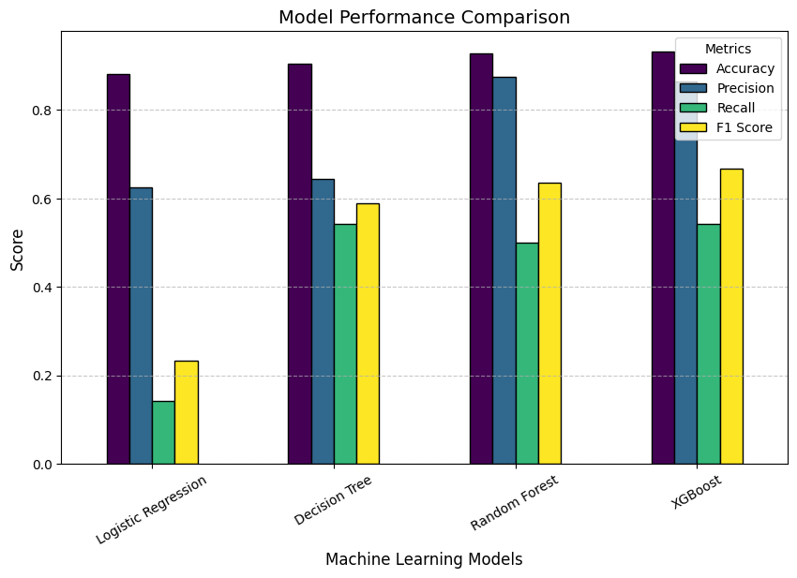
Model Performance

Slide 9
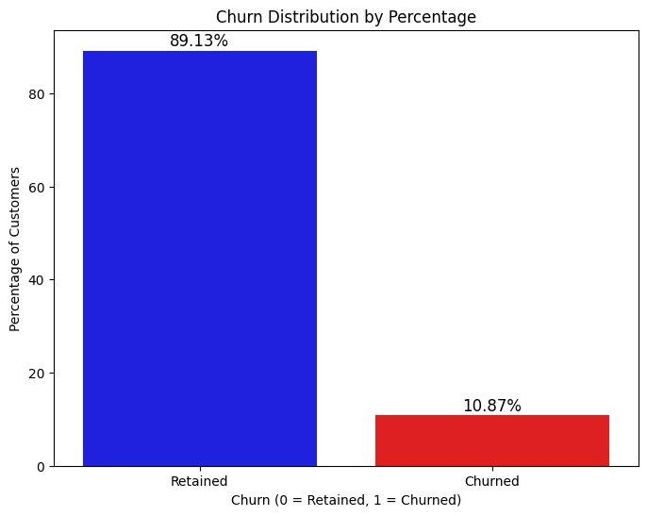
Churn Distribution in the Dataset

Slide 10
Feature importance for churn prediction

Slide 11
Conclusion
Deploy XGBoost or Random Forest for real-time churn prediction.
Monitor customer behavior continuously to update the model with new insights.
Implement A/B testing to measure the effectiveness of retention strategies.
Refine marketing campaigns based on churn predictions to optimize budget allocation.

Slide 12
Recommendations
Integrate the churn prediction model into the company’s CRM system for automated alerts.
Develop personalized customer engagement strategies based on churn risk levels.
Monitor and improve model performance periodically using updated customer data.

Slide 13
Thank you!
Presented by: Jael Kirwa

